Slide 1
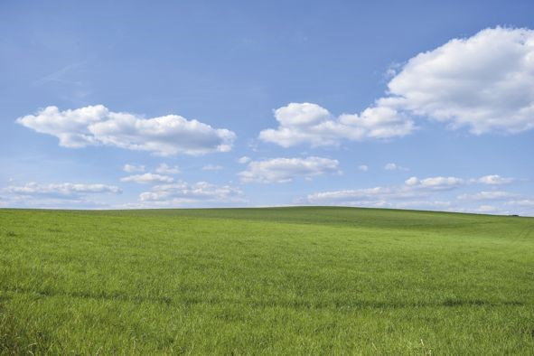
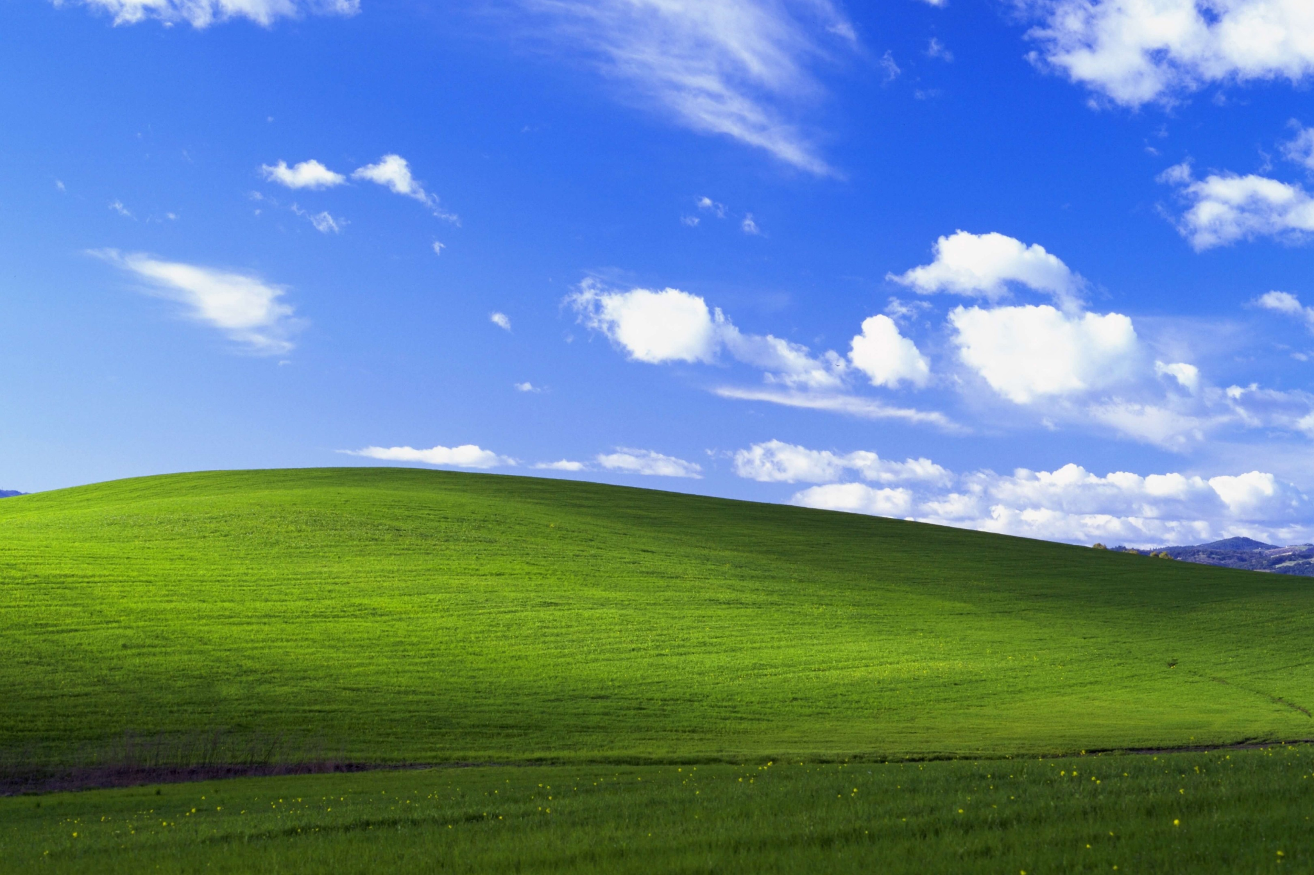
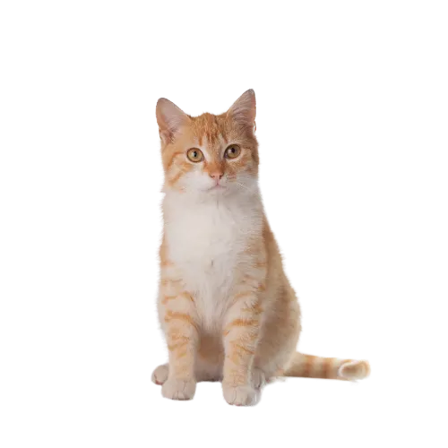
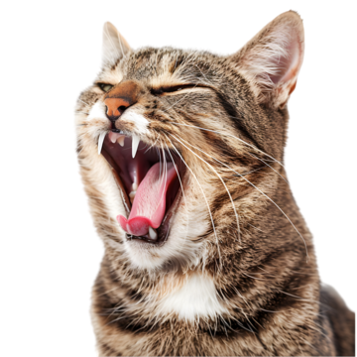
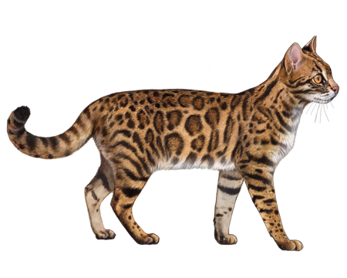
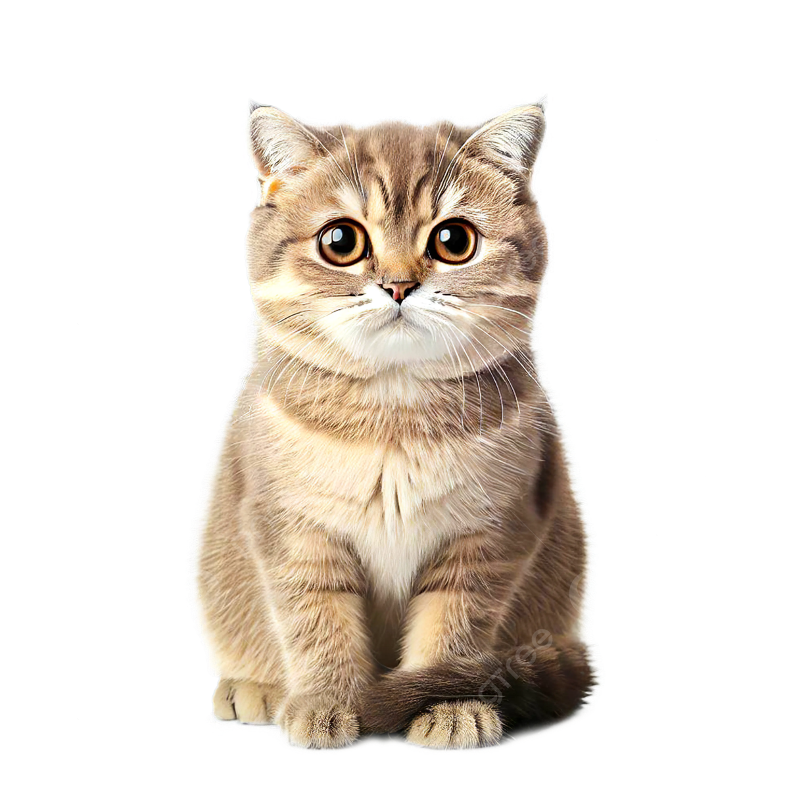
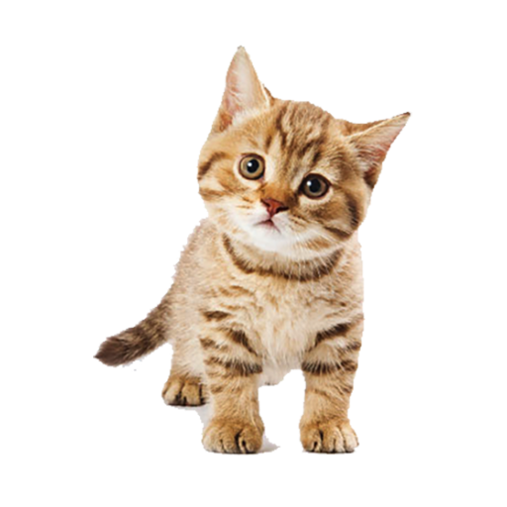
CATastrophe
when cats need a lil bit of inpinting

Slide 2
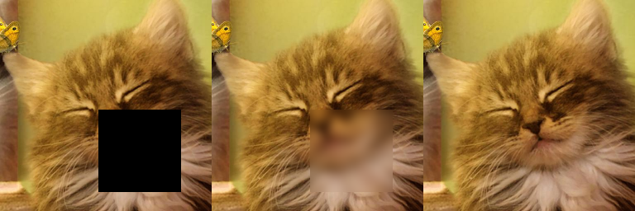
Concept

Slide 3
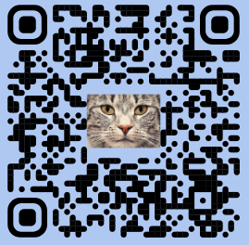
Data
name: Animal Faces-HQ (AFHQ)
16,130 images belonging to 3 classes
Cat
Dog
Wildlife
512×512 resolution

Slide 4
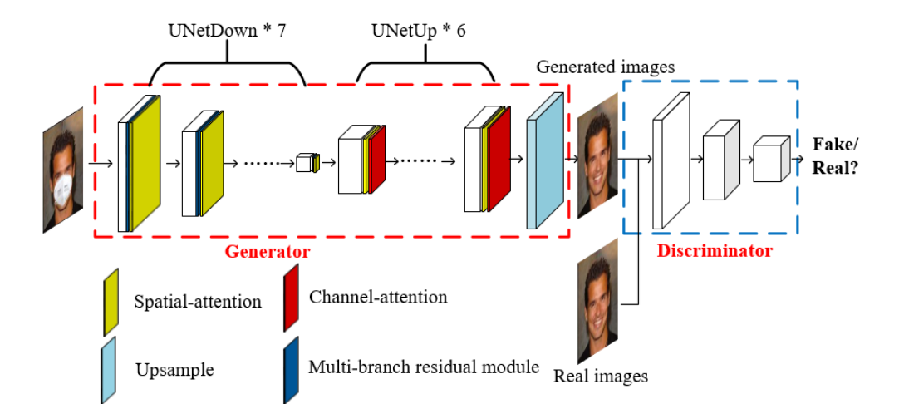
Approach
GAN
inspired by papers
done by me
5
5

Slide 5
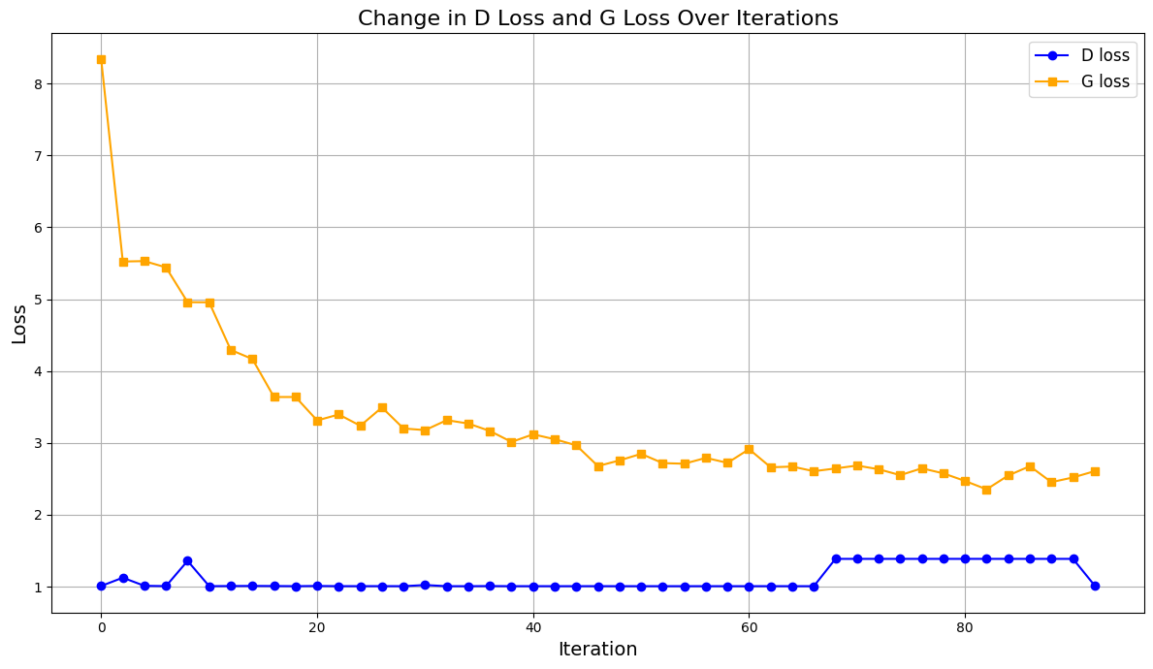
Approach GAN

Slide 6
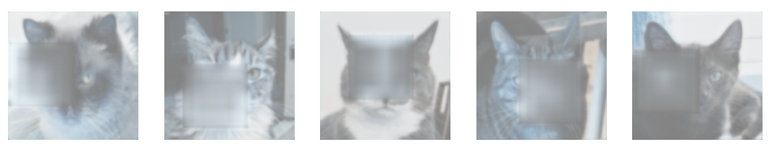
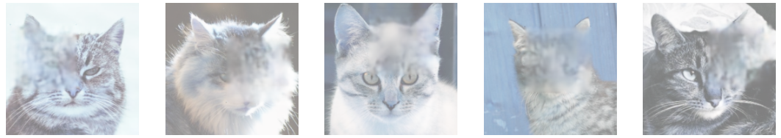
Approach GAN

Slide 7
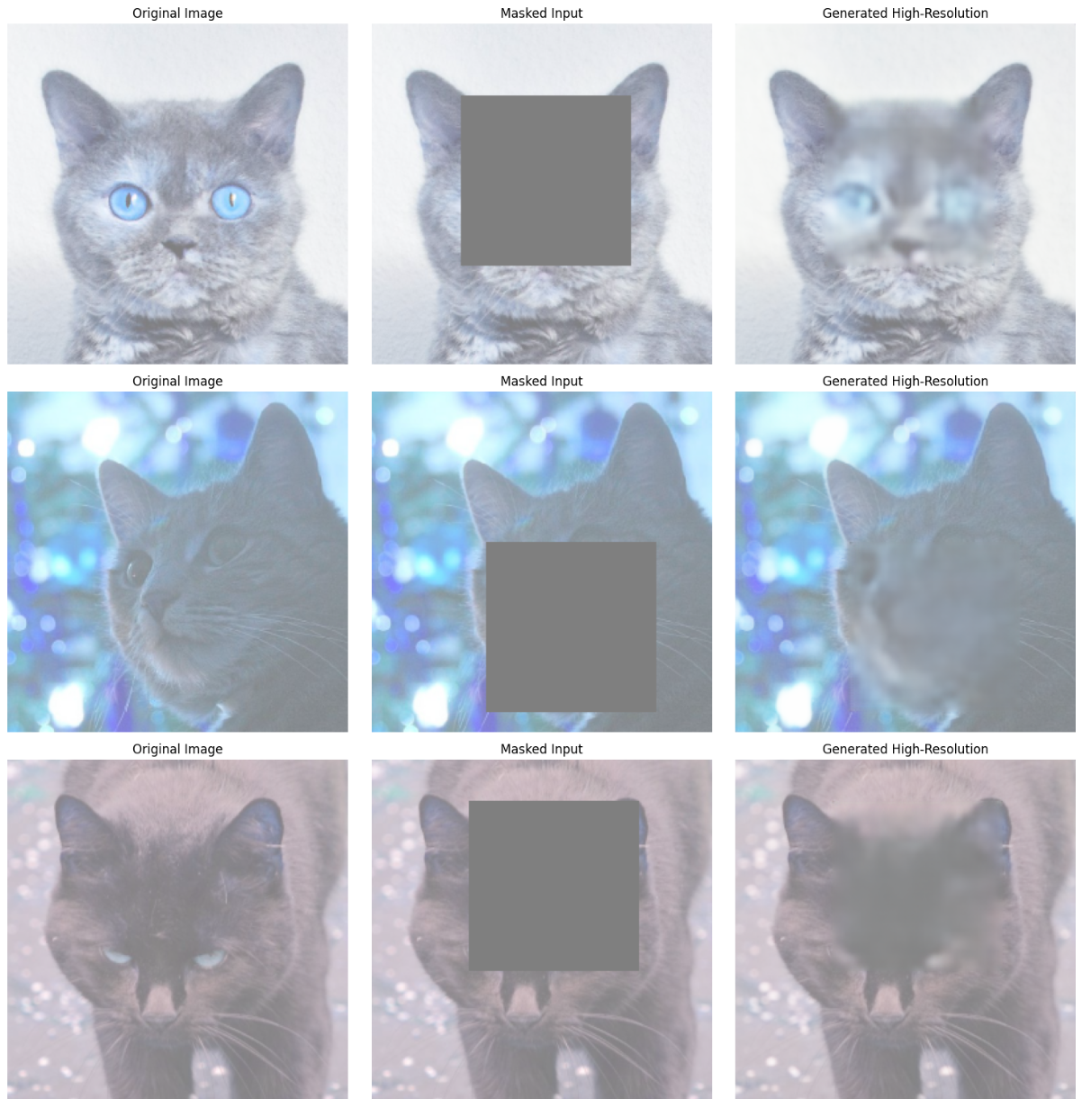
Approach GAN
some results are even better

Slide 8
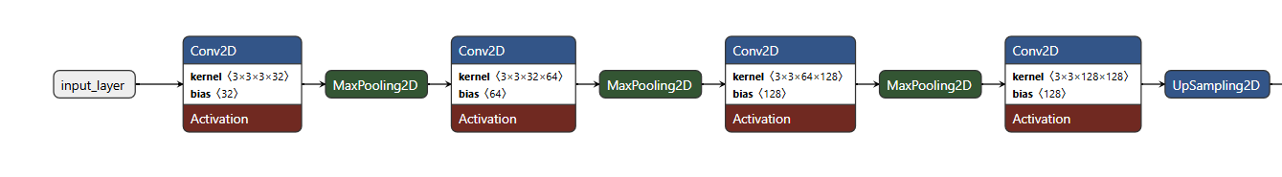
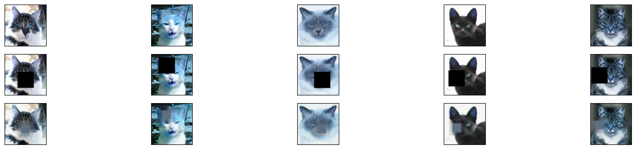
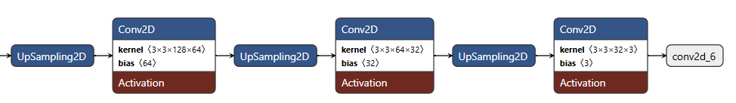
Approach
2. CNN

Slide 9
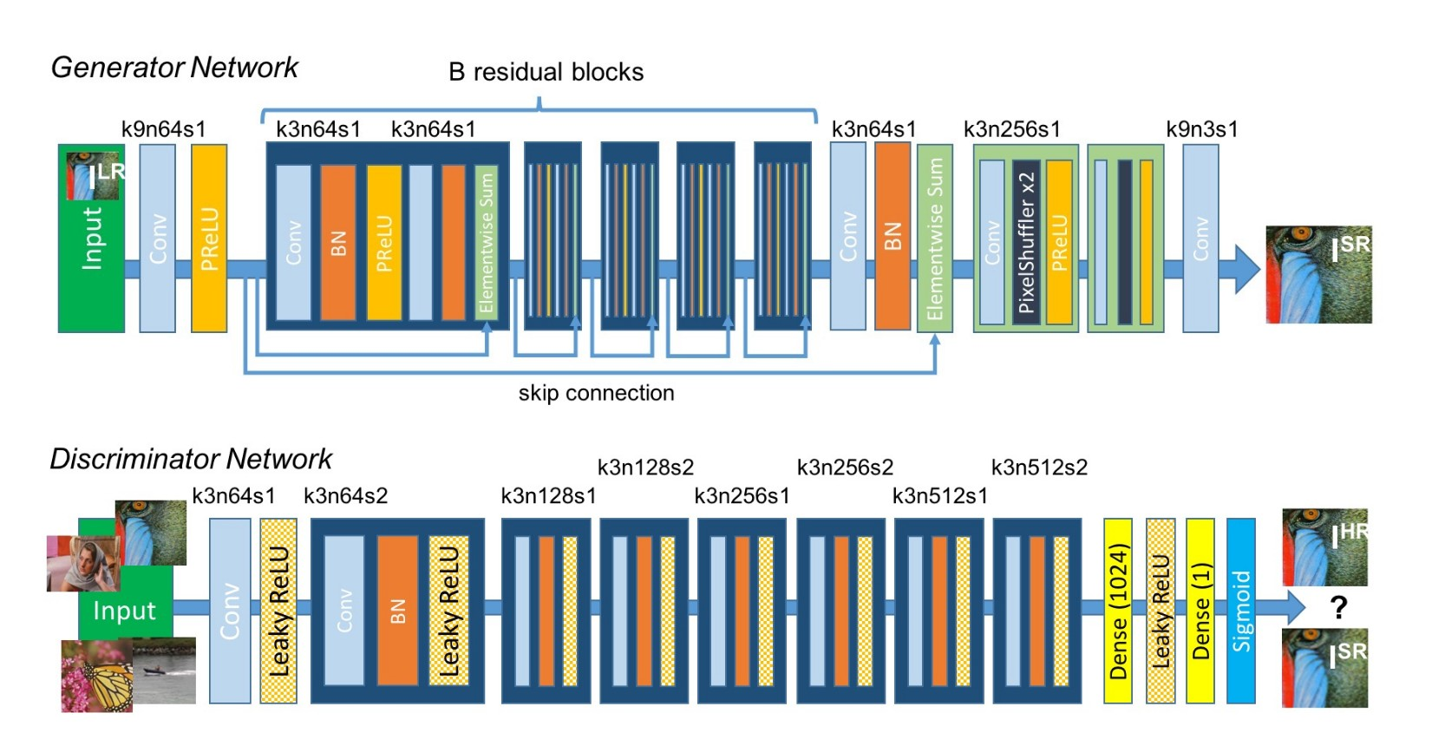
Approach Post-processing
3. Keras-SRGAN
Photo-Realistic Single Image Super-Resolution Using a Generative Adversarial Network implemented in Keras
by deepak112

Slide 10
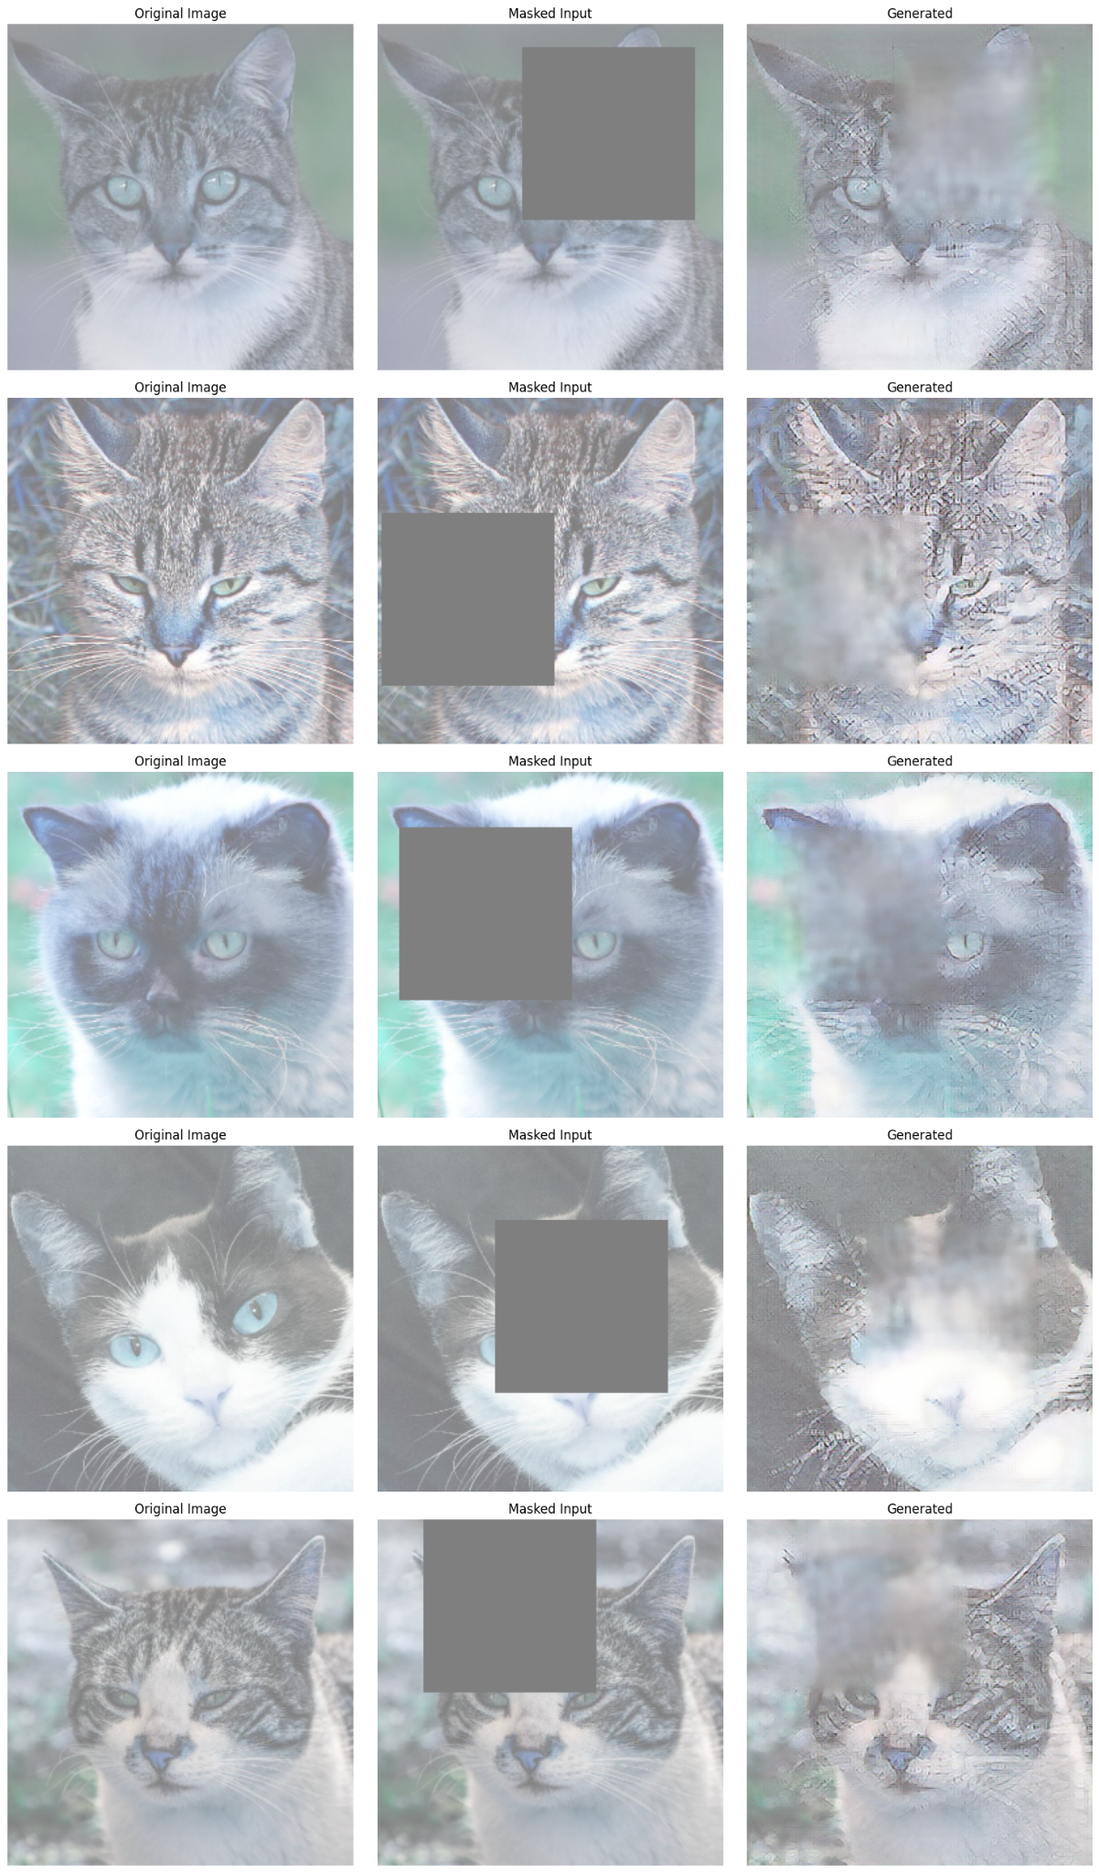
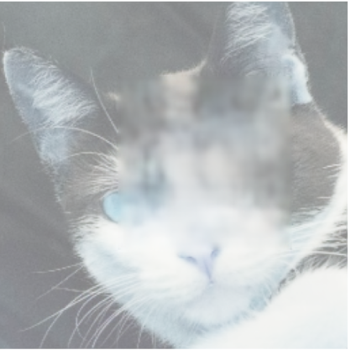
Approach Keras-SRGAN

Slide 11
Approach Post-processing
4. my GAN *2
training the same structure also on the initial results to “fix” the images
5
5

Slide 12
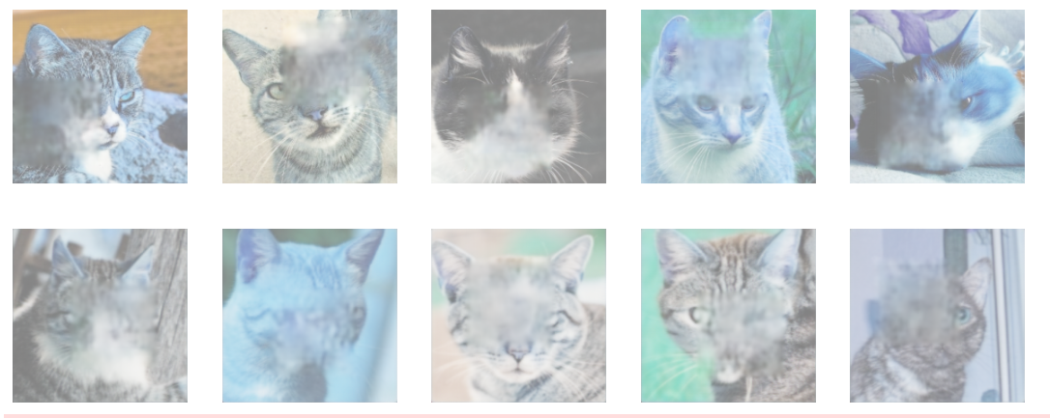
Approach GAN *2

Slide 13
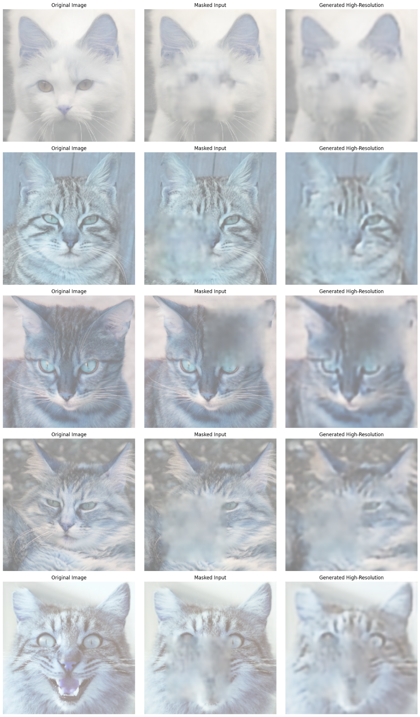
Approach Post-processing
5. CNN
to fix the image

Slide 14
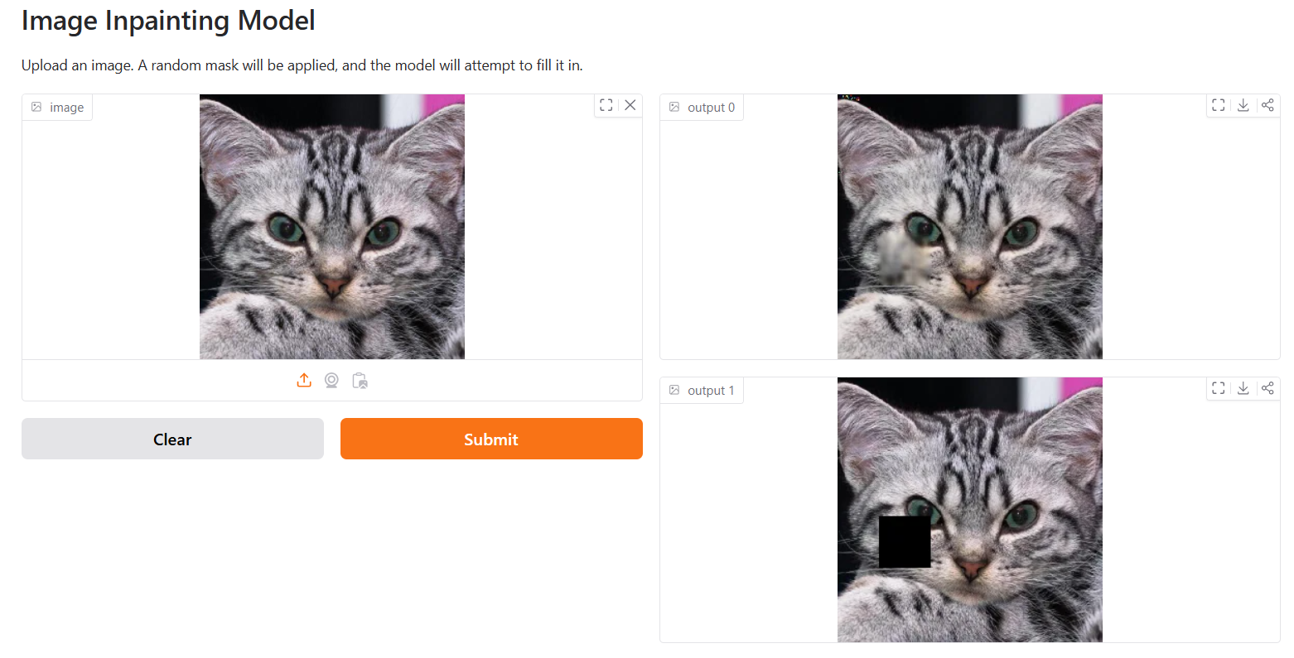
Huggingface

